Slide 1

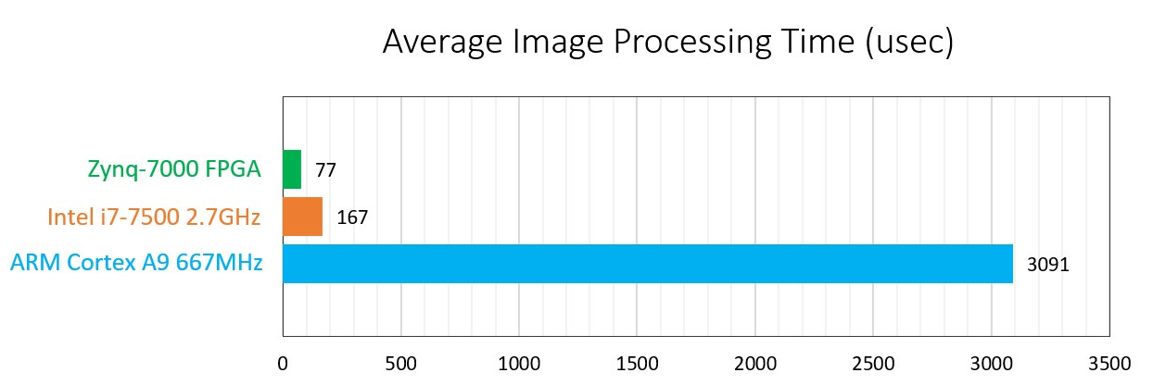
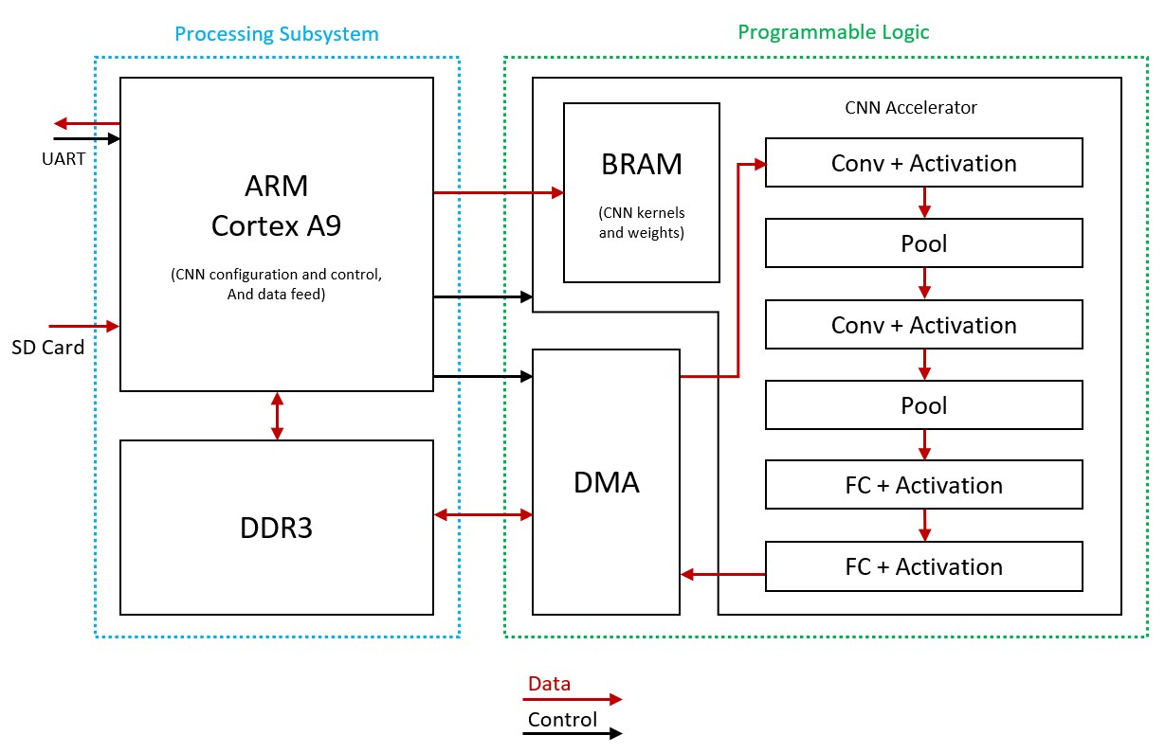
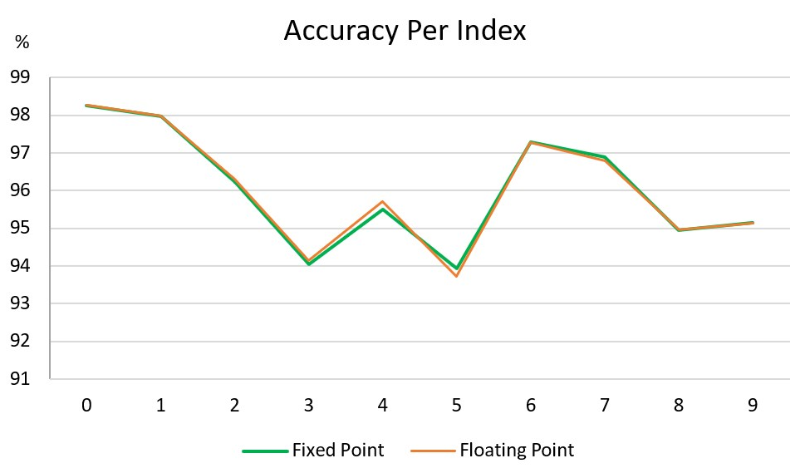
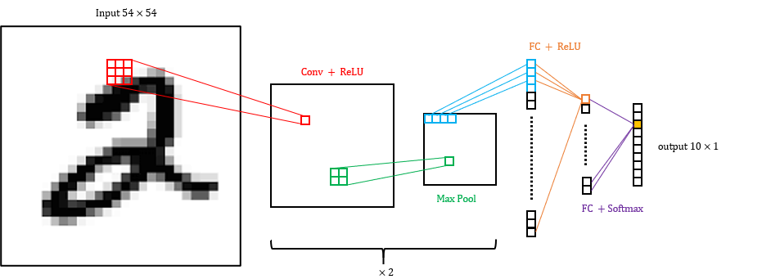
CNN Acceleration and Simulation on an FPGA
Project Number: 20-1-1-2187
Names: Chaim Gruda, Shay Tsabar
Advisor: Yoni Seifert
Introduction In recent years image analyzing and recognition has become a vital feature in ever more applications, ranging from autonomous vehicles, security, healthcare and more. Convolution neural networks (CNN) algorithms are widely used in many such applications since their high accuracy for image recognition. However, with the high accuracy come long computation time and high power needs. The need to include such image recognition capabilities in embedded systems with tight real-time and power constraints, lead the design for hardware accelerators for CNNs. An FPGA based CNN accelerator was implemented in this project. Objectives Talk about CNN configuration, and how acceleration is/can be achieved | Implementation PL, PS … Also talk about simulation Results | Results Conclusions

